Slide 1

Users Car Prediction for Indian Markets
By: Kyle Hostetter

Slide 2
Problem Definition
The demand of new cars in Indian markets is going down.
Increase in demand for used cars.
More features are used to estimate a used car’s value.
Get the greatest sale or profit when buying or selling a used car.
Making accurate and precise predictions for a car’s value.

Slide 3
Key Questions
What feature has the highest correlation with Price?
How are features encoded for prediction input features?
What must be done to the data in order to give valid predictions?
What category of cars is this model best suited for?

Slide 4
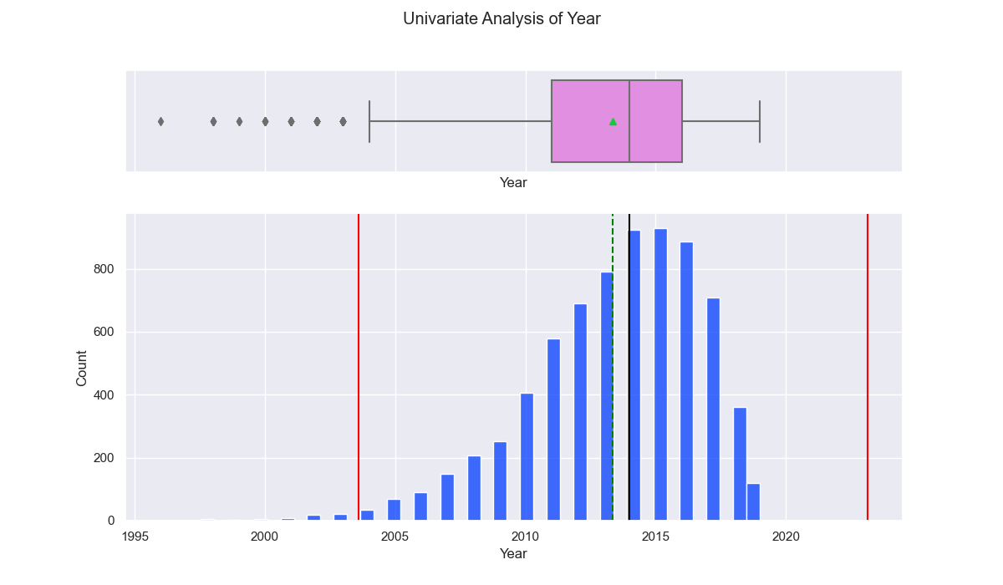
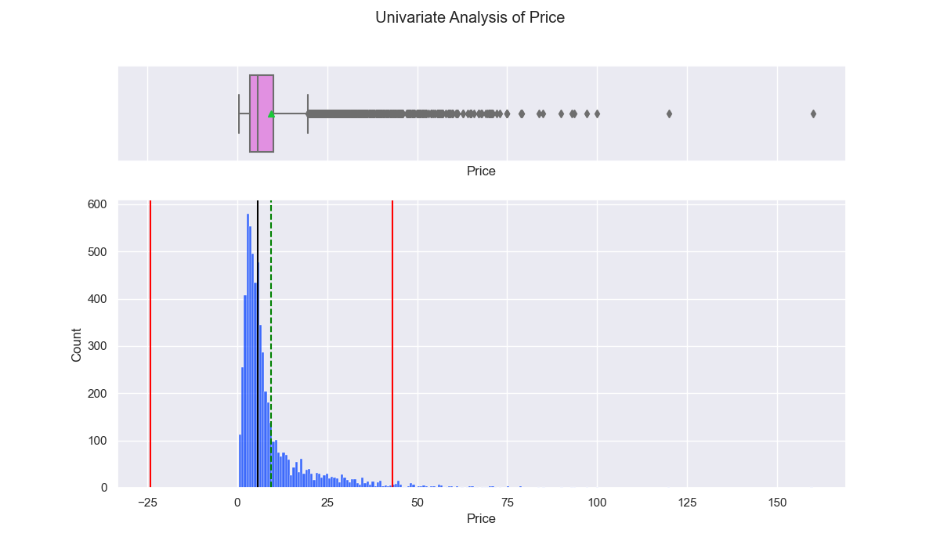
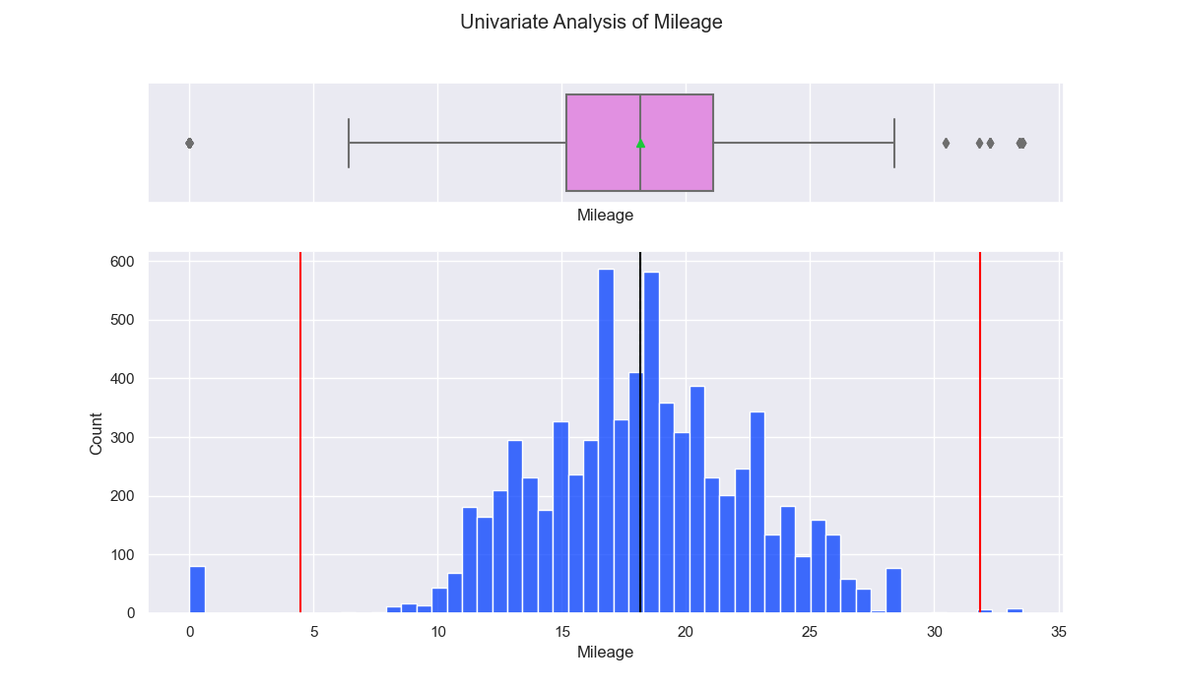
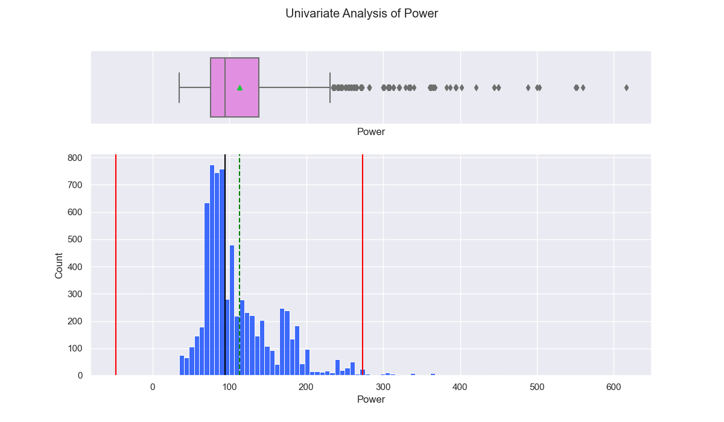
Continuous Feature Distributions

Slide 5
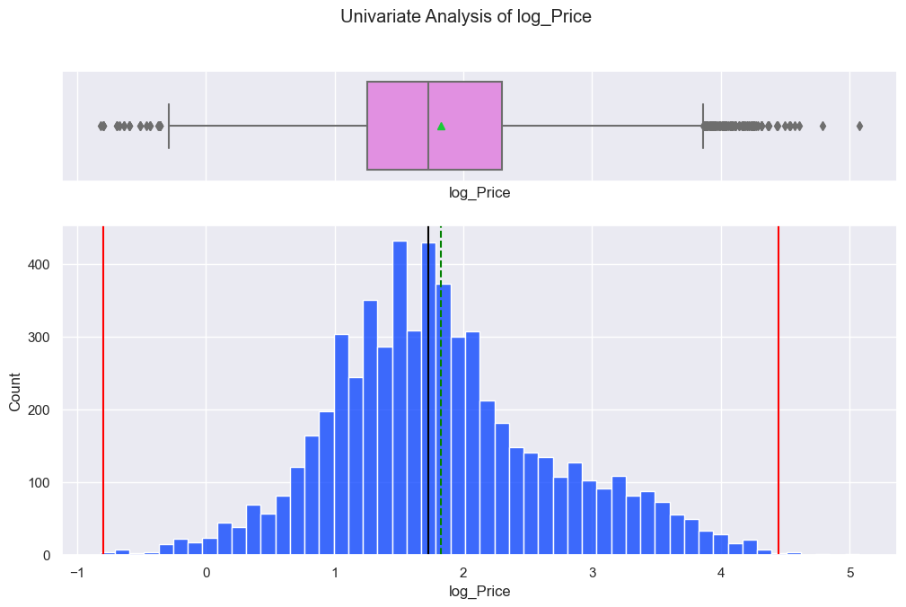
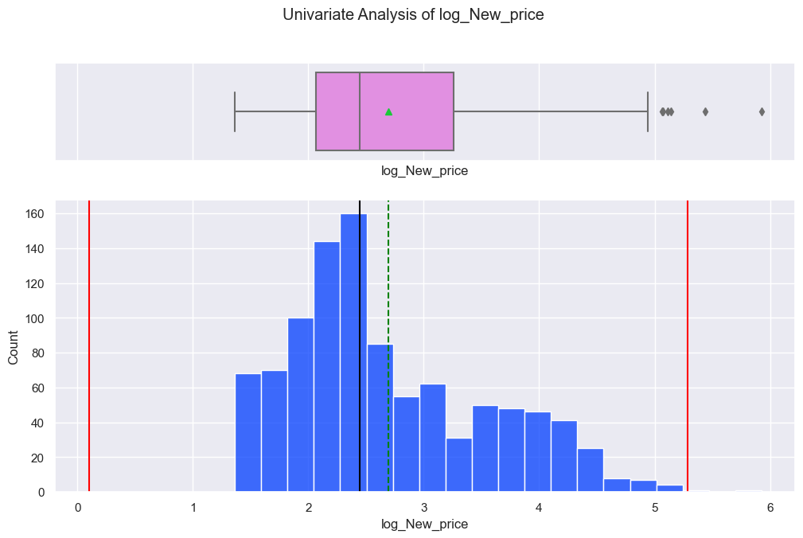
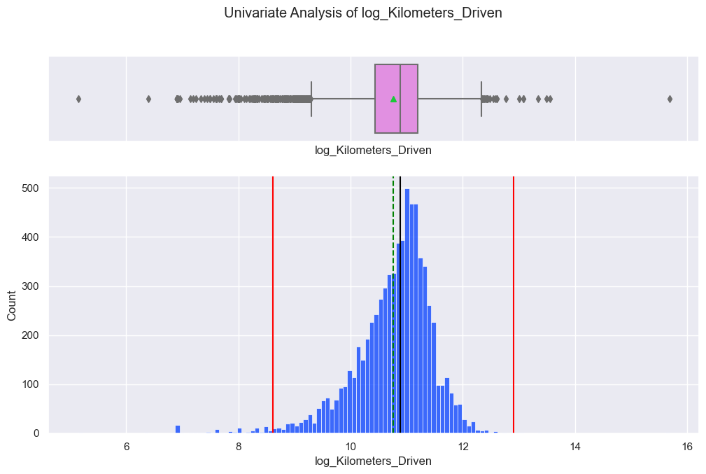
Log Transformed Feature Distributions

Slide 6
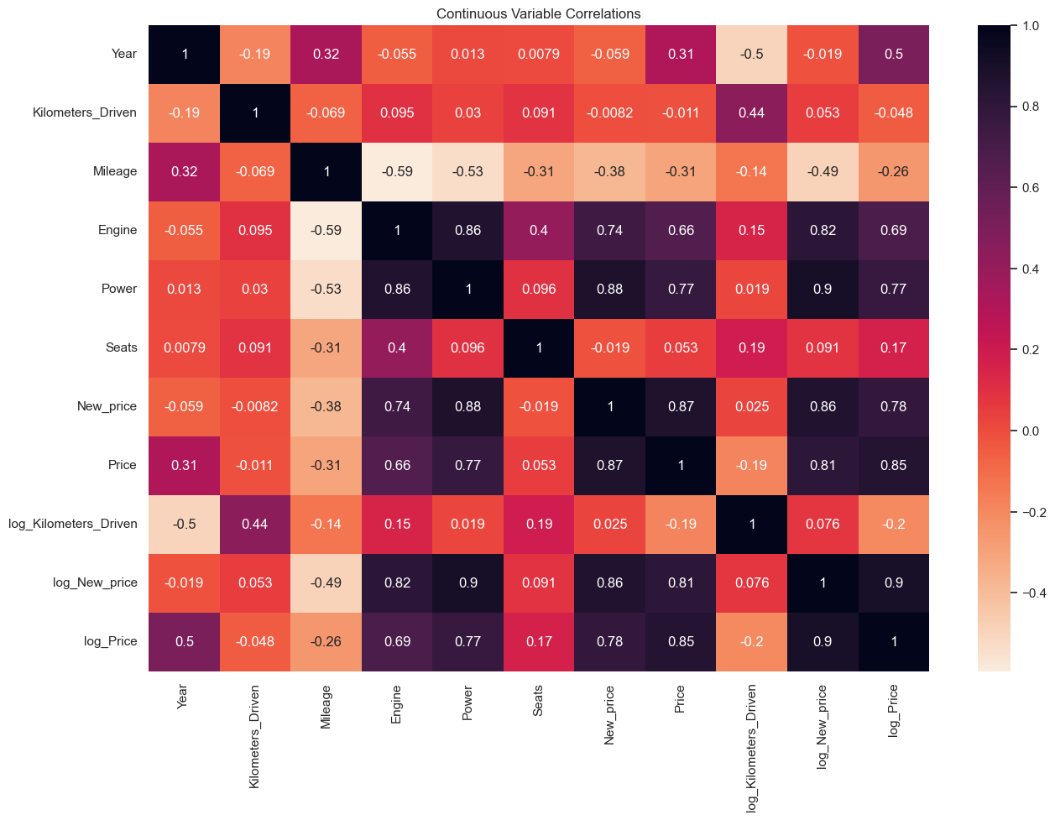
Continuous Features vs. Price
Highest Correlations
Power: 0.77
Engine: 0.69
Year: 0.5
Lowest Correlations
Seats: 0.17
Log_Kilometers_Driven: -0.2

Slide 7
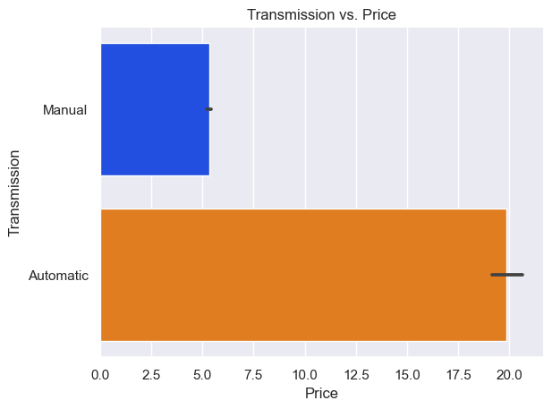
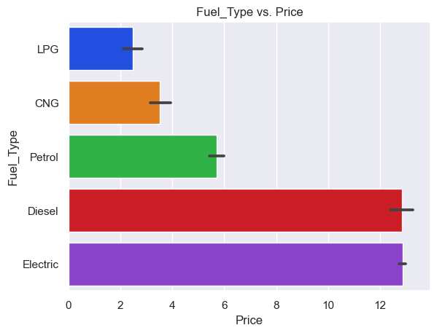
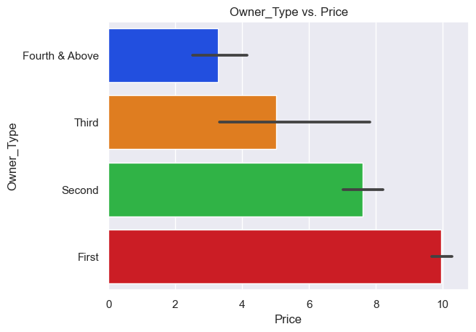
Categorical Features vs. Price

Slide 8
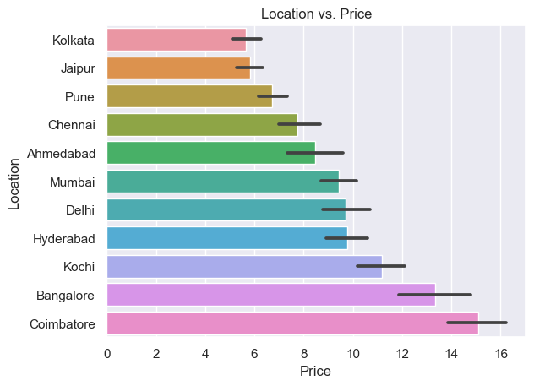
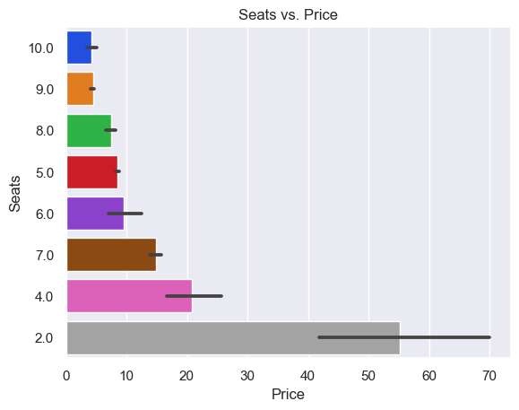
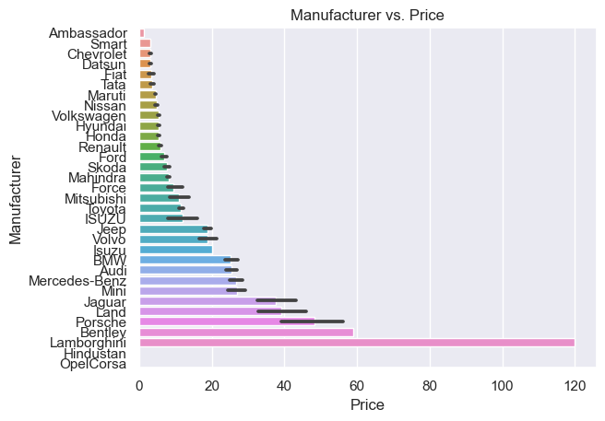
Categorical Features vs. Price

Slide 9
What features were used as inputs?
Input Features
Location
Year
Fuel Type
Transmission
Owner Type
Mileage
Engine
Power
Seats
Manufacturer
Log Kilometers Driven
Features Removed
Kilometers Driven
New Price
Serial Number
Target Feature
Log Price

Slide 10

Solution Algorithm
A number or continuous value is predicted.
Regression models.
R-squared is used to measure model performance.

Slide 11
Machine Learning Models Used
Random Forest Regression
Decision Tree Regression
Lasso Regression
Linear Regression
Ridge Regression

Slide 12
Encoding Process
OneHotEncoding
This process give equal bias to each categorical feature values.
Price correlated Encoding
Encoding feature values based on their average price for that category.

Slide 13
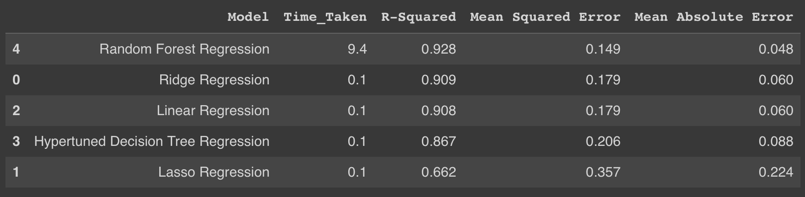
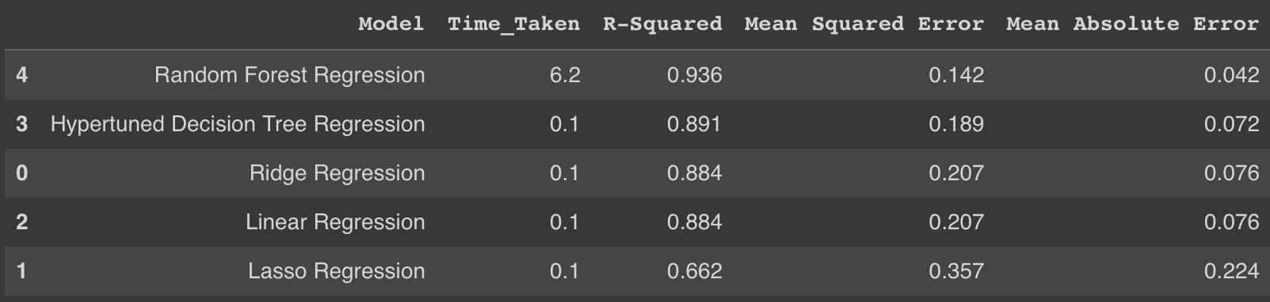
Final Model
OneHotEncoding
Price correlated Encoding

Slide 14
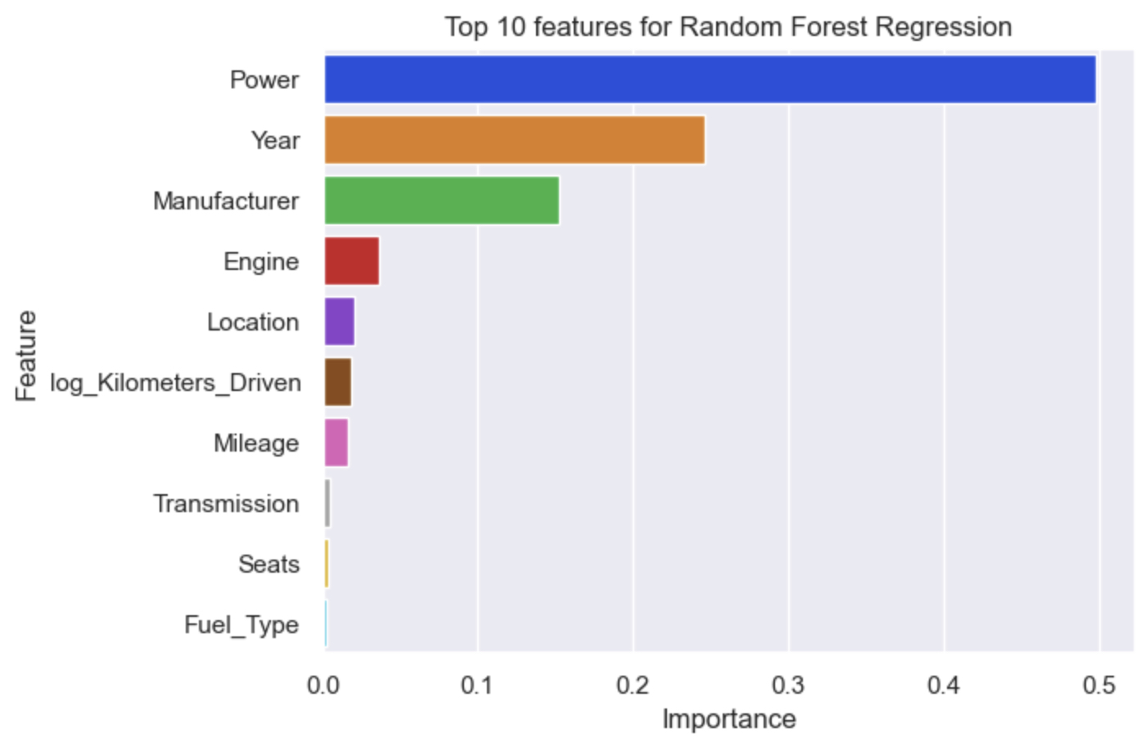
Feature Importance
Most Important Features
Power
Year
Manufacturer
Least Important Features
Transmission
Seats
Fuel Type

Slide 15
Business Recommendations
Gather data about market conditions.
Create a more diverse set of car manufacturers including exotic vehicles.
Adapt model predictions to supply and demand data.

Slide 16
Appendix

Slide 17
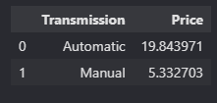
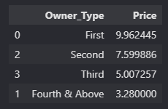
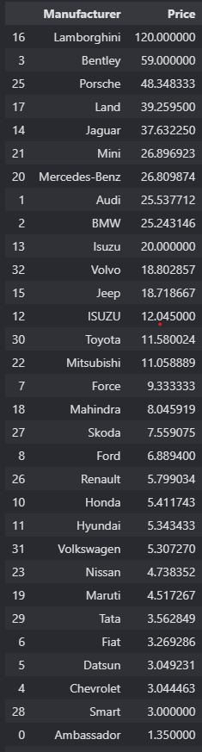
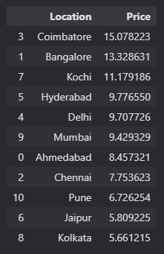
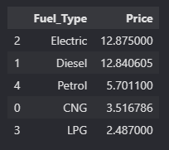
Categorical Feature Data

